Slide 1
LONG SHORT-TERM MEMORY
By Sepp Hochreiter, Jürgen Schmidhuber
Presented by: Aniket, Vishwa, Meghashree, Dhruval

Slide 2
Previous Work and Problems with it
Recurrent Neural Networks
Problems With RNN:
Short-Term Memory Challenge
Algorithmic Limitations
Issues in Backpropagation
Weight-Dependency Challenges
Application Significance

Slide 3
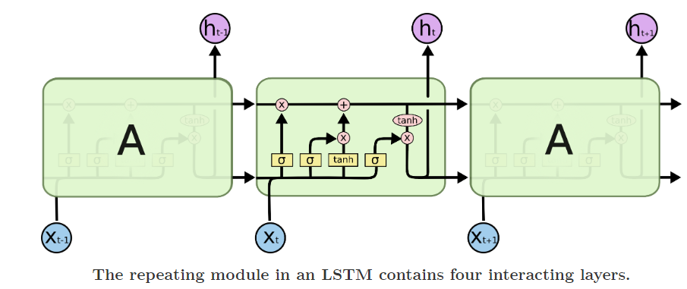
LSTM Explanation

Slide 4
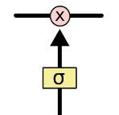
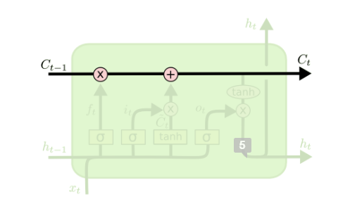
Cell state
Information stored and removed by gates
Composition of sigmoid neural net layer and pointwise multiplication

Slide 5

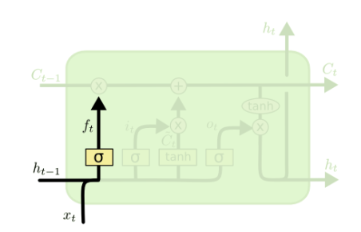
Forget gate
To decide whether to keep information in cell state of discard completely
Notes:
In such a problem, the cell state might include the gender of the present subject, so that the correct pronouns can be used. When we see a new subject, we want to forget the gender of the old subject.

Slide 6
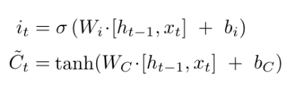
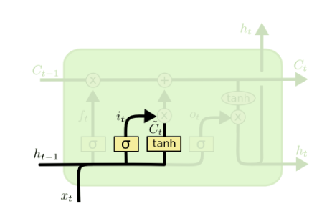
Input gate
To decide what information to store in cell state

Slide 7
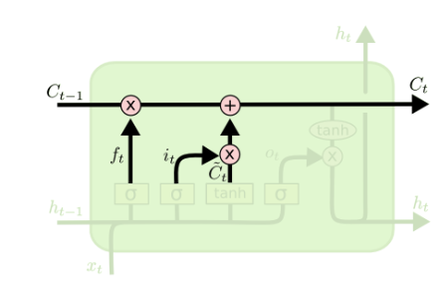

Update value in cell state
Notes:
In the example of our language model, we’d want to add the gender of the new subject to the cell state, to replace the old one we’re forgetting.

Slide 8

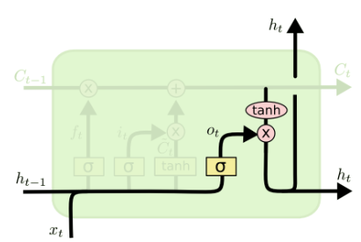
Output gate
Based on cell state
Sigmoid layer to decide part of cell state for output
Put the cell state through tanh layer
Notes:
For the language model example, since it just saw a subject, it might want to output information relevant to a verb, in case that’s what is coming next. For example, it might output whether the subject is singular or plural, so that we know what form a verb should be conjugated into if that’s what follows next.

Slide 9
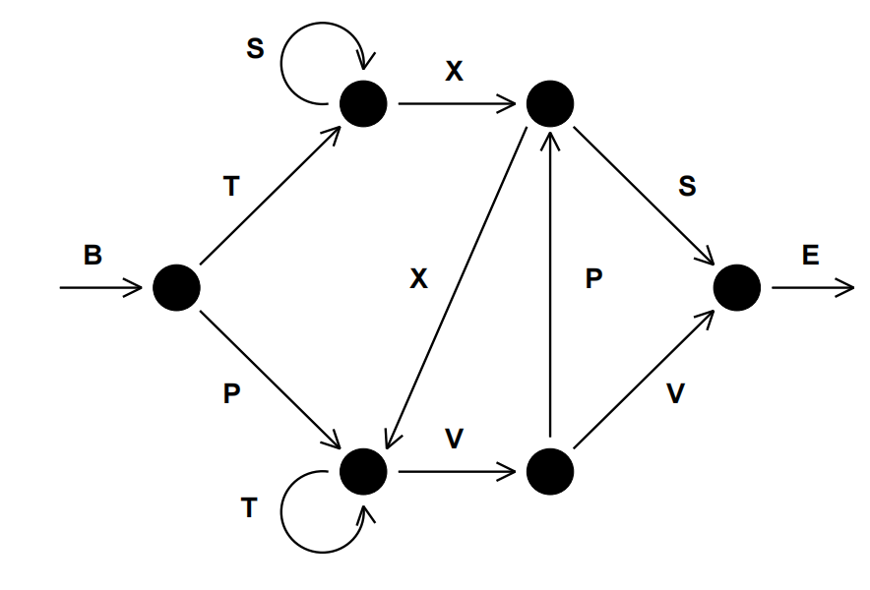
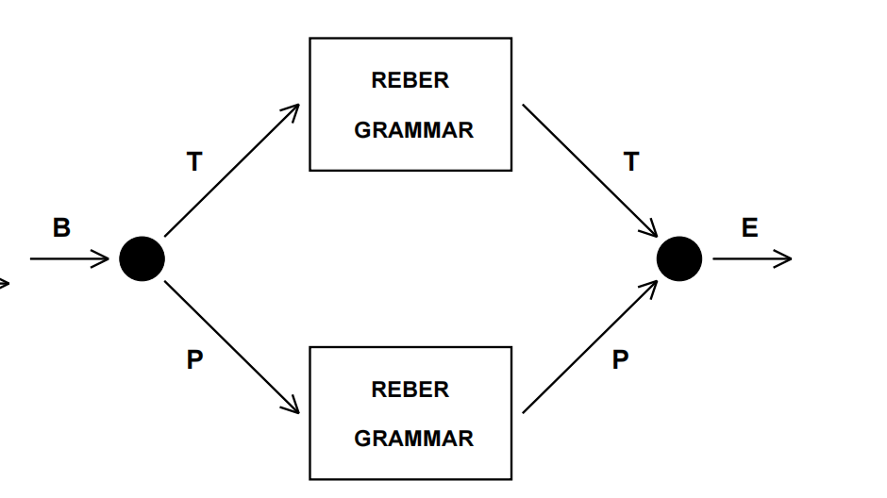
Experiment 1: Embedded Reber Grammar
Transition diagram for the Reber grammar.
Transition diagram for the embedded Reber grammar. Each box represents a copy of the Reber grammar

Slide 10
Reber Grammar is type of artificial grammar used to test the sequential learning capabilities.
Start State : B
End State : E
Transition States : P,T,X,V,S
The task for the neural network was to read these symbol strings and predict the next symbol in the sequence correctly.

Slide 11
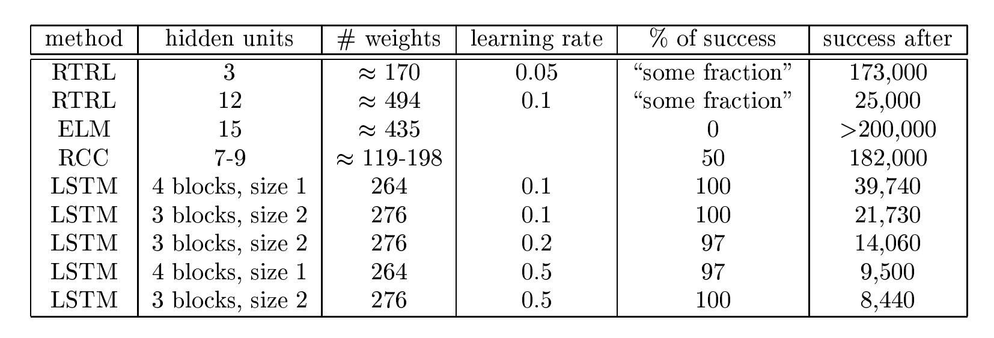
Results of the first experiment

Slide 12
Experiment 2: Noise-Free and noisy sequences
Task 2a: The task is almost similar to Reber grammar. The sequence begins and ends with either ‘x’ and ‘y’ and contains the symbols in between vary. The aim is to remember the sequence even with long time gaps.
Task 2b: The sequence is mixed with noise. The procedure is same as Task 2a
Task 2c: The task is more complicated than the other two tasks. The input sequence contained more noise and randomness.
The goal in all the three tasks was to solve the problems even when there was long time lags.

Slide 13
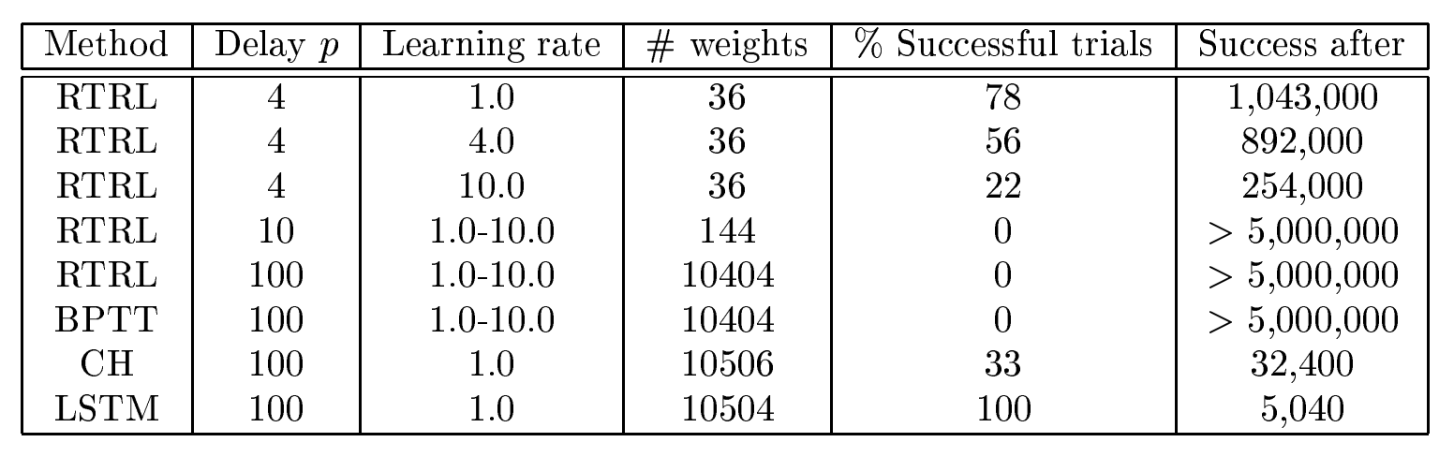
Results of task 2a:

Slide 14
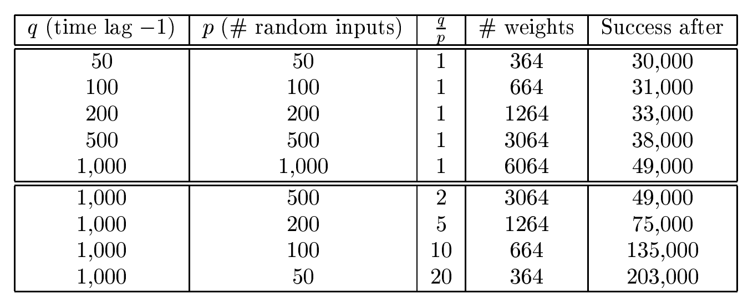
Results of task 2c:

Slide 15
Experiment 3: Noise and signal on same channel
Aim is to predict which group the sequence belonged to. There were two groups.
The input sequence starts with the important information and the rest of it was noise.
The length of the sequence and the complexity was increased with each task.
There were two stopping criterions.
LSTM computer program can still solve this problem even with the increased difficulty with each task.

Slide 16
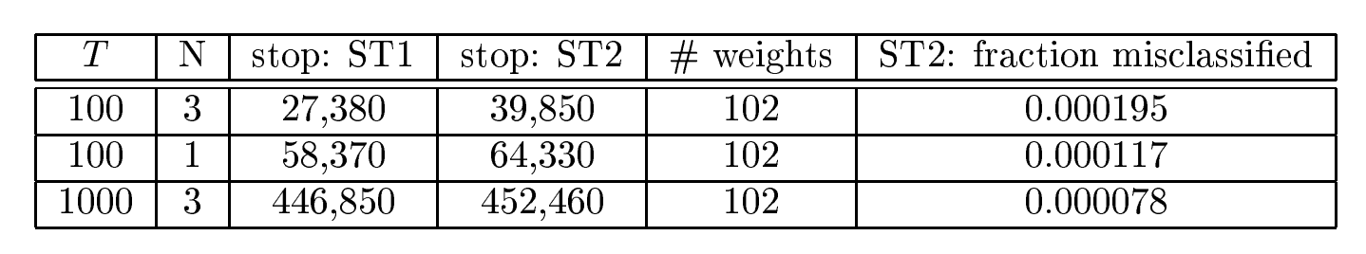
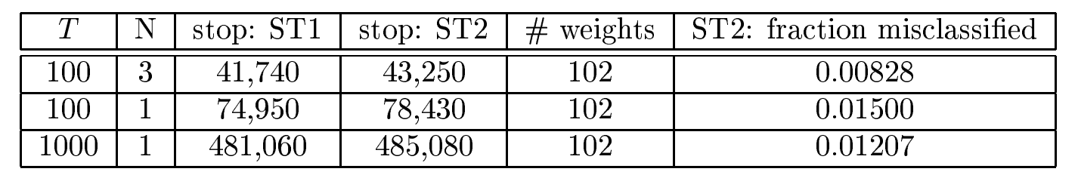
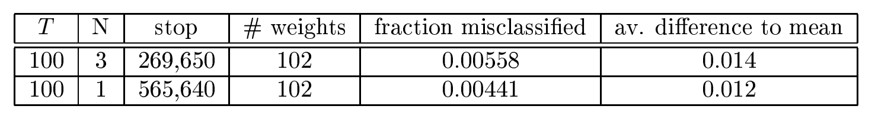
Results of experiment 3:
TASK 3a
TASK 3b
TASK 3c

Slide 17
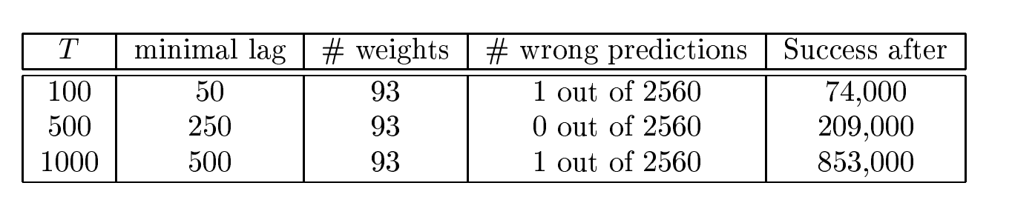
Experiment 4: Adding Problem
The Aim was to sum up a pair of particular numbers in the given sequence.
The first number was random. The second number was considered a marker.

Slide 18
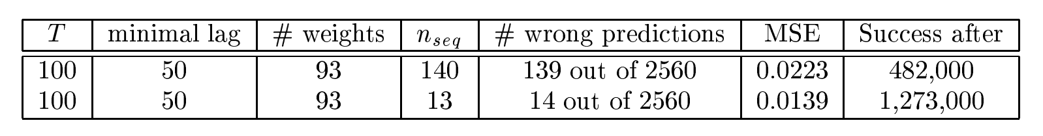
Experiment 5: Multiplication Problem
Results of experiment 5:
Similar to Addition problem experiment.
Multiplication is performed instead of addition.

Slide 19
Experiment 6: Temporal order
This experiment contains two tasks.
Start of the sequence : E
End of the sequence : B
Random symbols : a, b, c or d.
Special symbols : X and Y
Target values : Q, R, S, U(Task A), Q, R, S, U, V, A, B, C (Task B)

Slide 20
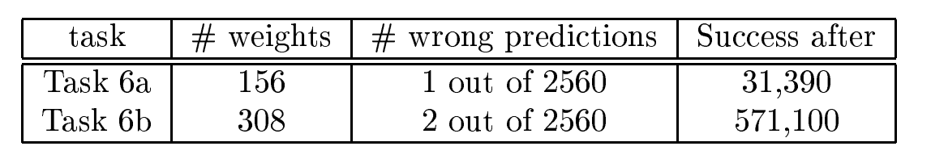
Results of experiment 6:

Slide 21
Summary of the experiments:
LSTM’s robustness to Noise
Long Time lags
Information extraction from complex sequences
Complex computations with continuous values.
LSTM can perform well on both simple and complex task.

Slide 22
LSTM limitations
Computational Complexity
Vanishing Gradient Problem
Exploding Gradient Problem
Additional Units in Memory Cells
Truncated Backpropagation

Slide 23
LSTM advantages
Long-Term Dependencies
Versatility
Effective Handling of Sequences
No Need for Parameter Tuning
Unlimited State Numbers

Slide 24
Thank You

